Slide 1


Students Practice in GREECE with Amber JOB
www.amberjob.eu

Slide 2






OUR PARTNERS
Luxury 4-5* Hotels located in Greek islands like Kos, Rhodes, Corfu, Crete, Lefkada, Zakynthos, Samos, Mykonos and many more...

Slide 3
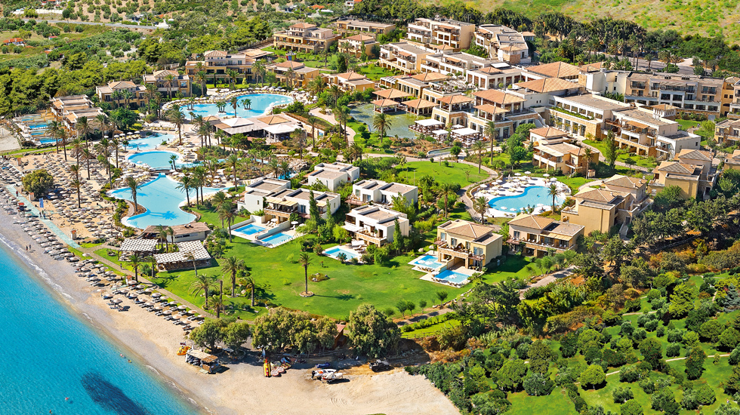

Slide 4


Slide 5
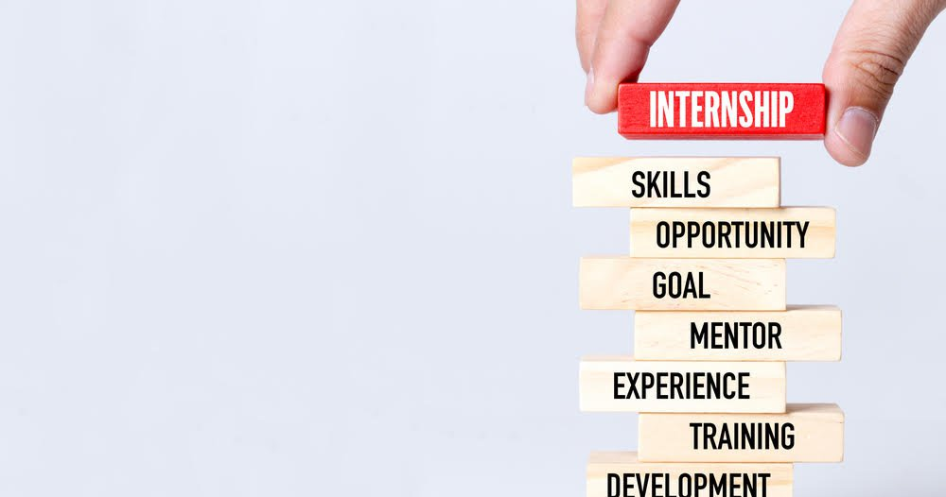

Internship positions:
Childcare worker
Sport/fitness activities trainee
Hotel daily events organizer
Reception and back office trainees
Food & Beverage department trainees:
assistant waiters/waitresses
hostess
kitchen assistants
SPA trainees

Slide 6
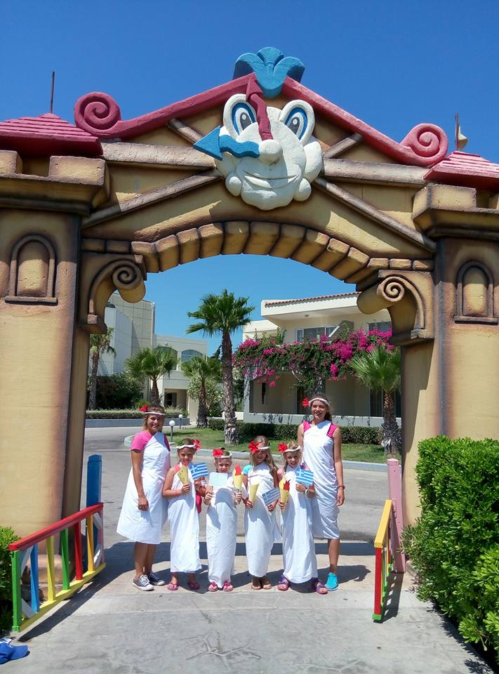
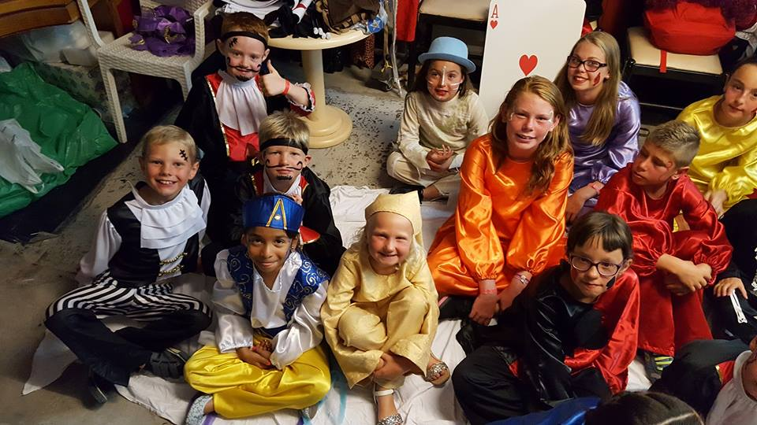
Childcare workers
Organizing thematic days and events for smallest hotels guests
Internship fits for pedagogy, primary education and social work and event management students.

Slide 7
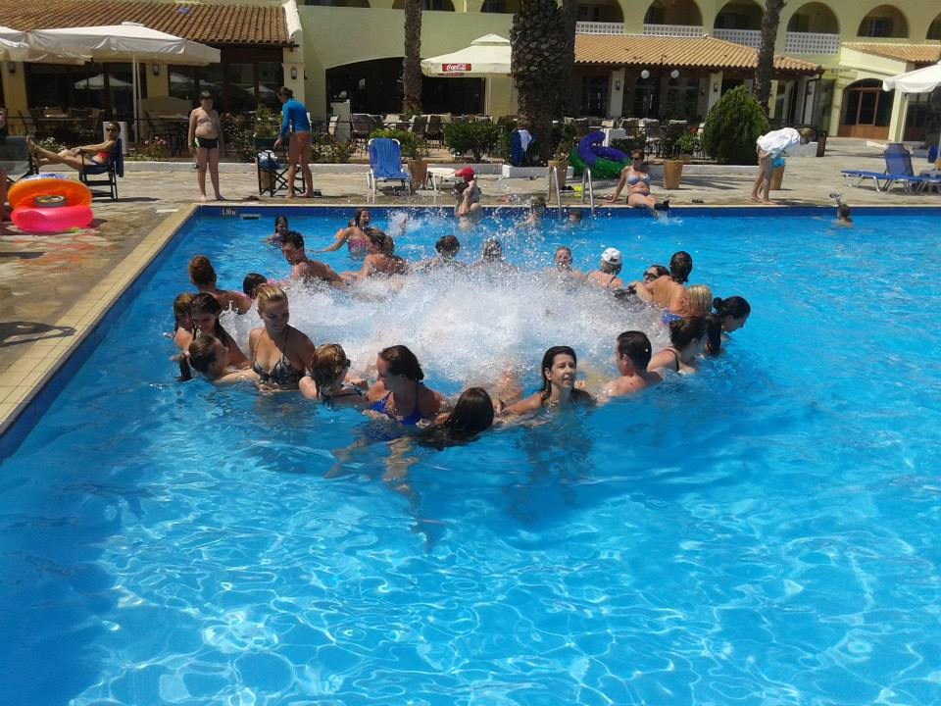
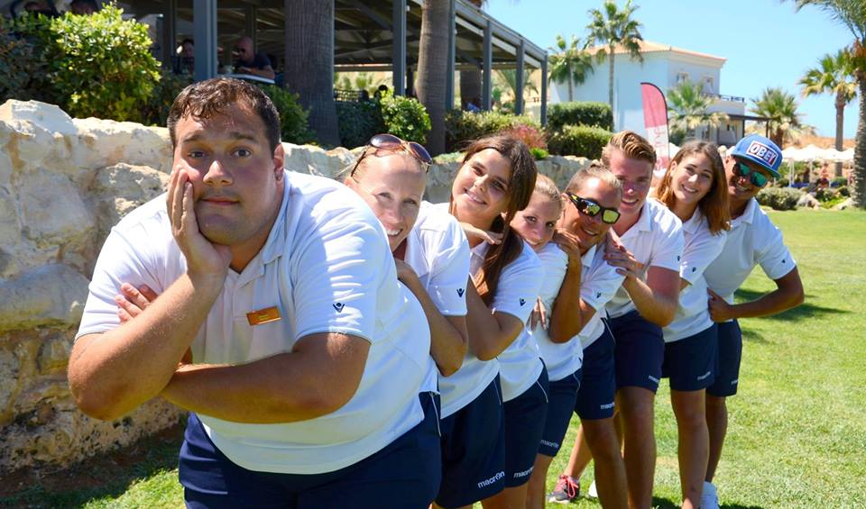
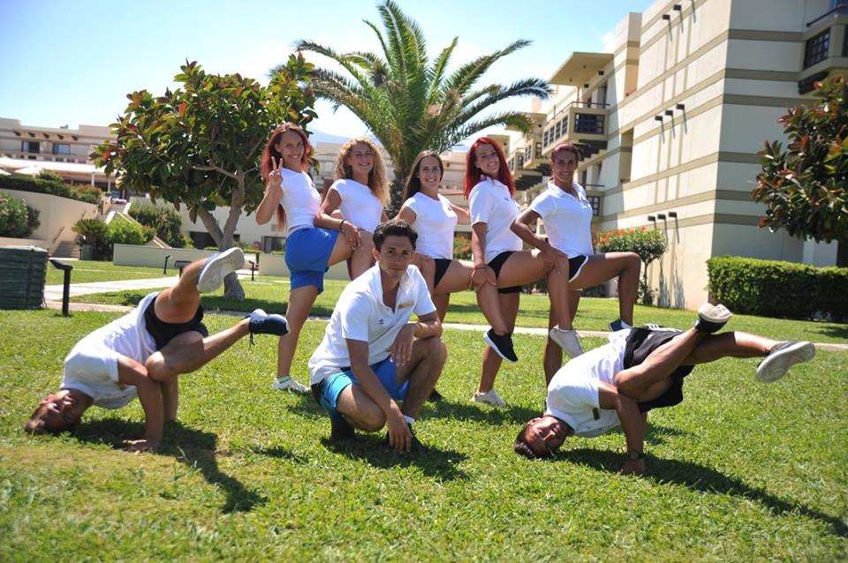
Sport/Fitness activities trainees organizing various sport activities and tournaments for hotel guests. Internship fits for sport education, kinesiotherapy, leisure education, events management students.

Slide 8
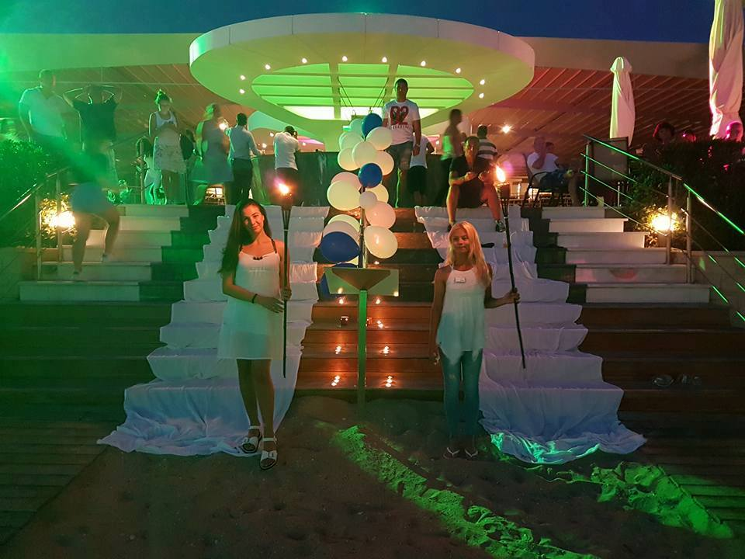
Hotel daily all around events organizers
Trainees are responsible for day and evening events as Greek festival, Neptune day, Family Olympics, evening variety show and others.
Perfect match for creative industries and events management students.

Slide 9

Food & Beverage department trainees
Tourism sector students have a chance get to know the activities, daily routine and specialties of 4-5 stars Hotels restaurants.
Assistant waiters, hostess, assistant cooks.

Slide 10
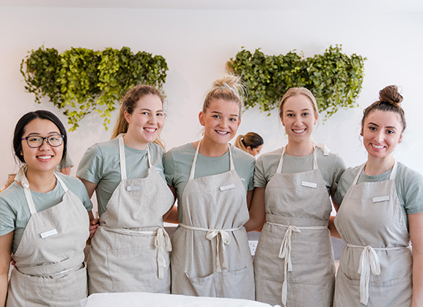
Trainees in the SPA centers
During internship beauty specialization students have a great opportunity to improve their practical knowledge in the luxury Greek SPA centers.

Slide 11
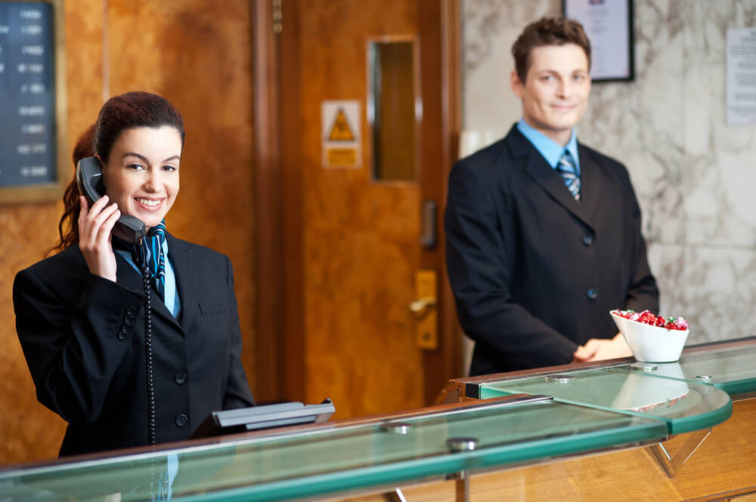
Trainees in the Hotel Reception and back office
Students will learn clerical tasks such as typing, logging into and using specific computer programs, answering phone calls, emails, filing paperwork, and performing other duties as direct communication with customers and colleagues.

Slide 12


Working conditions
Practice from 3 months
6 days per week
Available positions for last year students too

Slide 13



Benefits and bonuses
Scholarship from hotel side from 400 euro per month
Erasmus scholarship from 600 euro per month from University/College
Free accommodation
3 meals per day
On real job training
Holiday working environment
Official training certificate
New friendship
Foreign language improvement
Combination of work and vacation

Slide 14

Students present:
CV in english with recent picture to
amberjobeu@gmail.com;
Copy of valid passport or
copy of EU resident permit card;
European health insurance card.

Slide 15
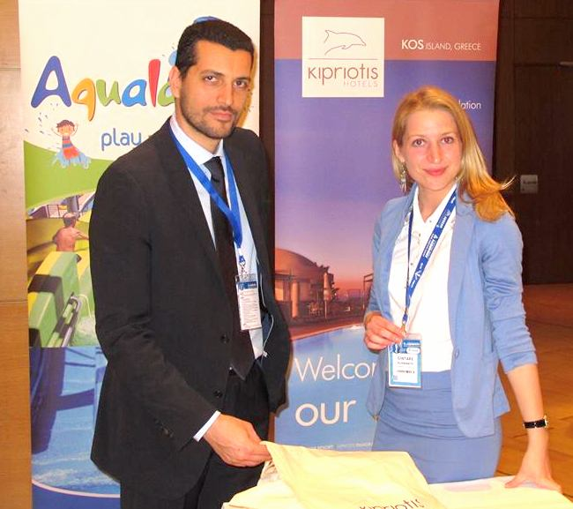
Personal experience
Some of our partners:
Lithuanian Sports University, Kaunas, Lithuania;
Riga State Technical school, Riga, Latvia;
Kauno Kolegija Higher Education Institution;
Kolping University of Applied Sciences, Kaunas, Lithuania;
University of Applied Social Sciences, Vilnius, Kaunas and Klaipėda, Lithuania
Vilnius University, Lithuania;
Mykolas Romeris University, Vilnius, Lithuania;
Lithuania Business University of Applied Sciences, Klaipėda and Vilnius, Lithuania
Vilnius Gediminas Technical University, Vilnius, Lithuania;
Vilnius University of Applied Sciences, Lithuania;
Etc…

Slide 16
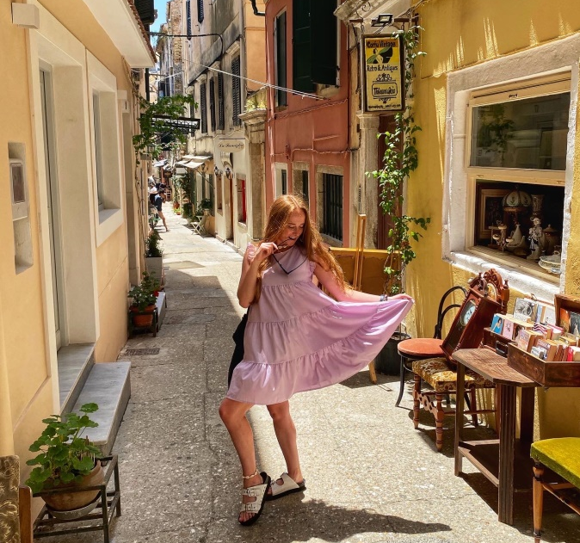
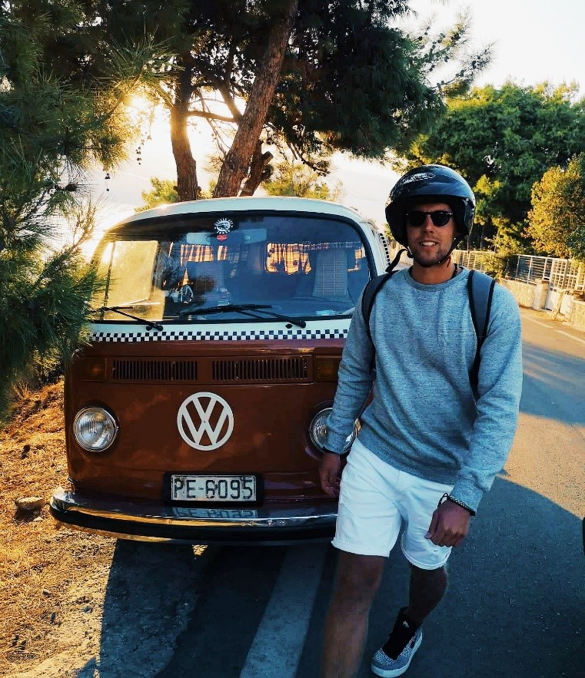
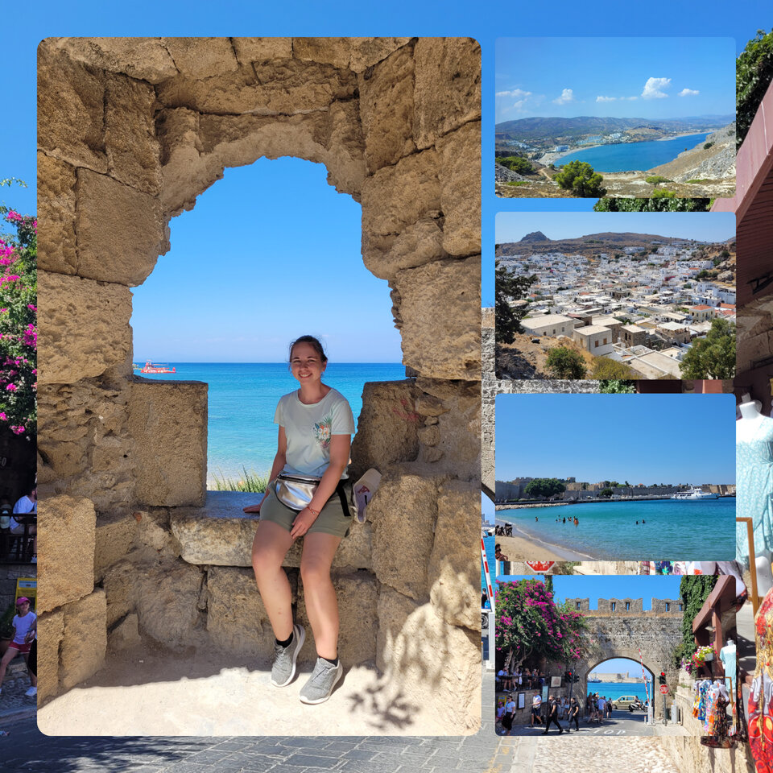
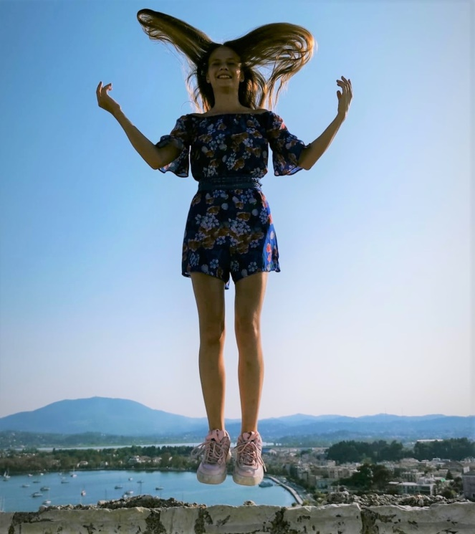
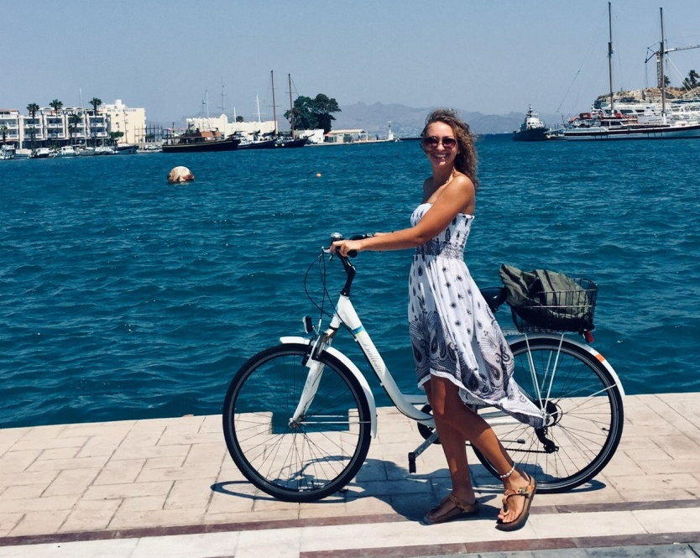
Our students in Greece

Slide 17
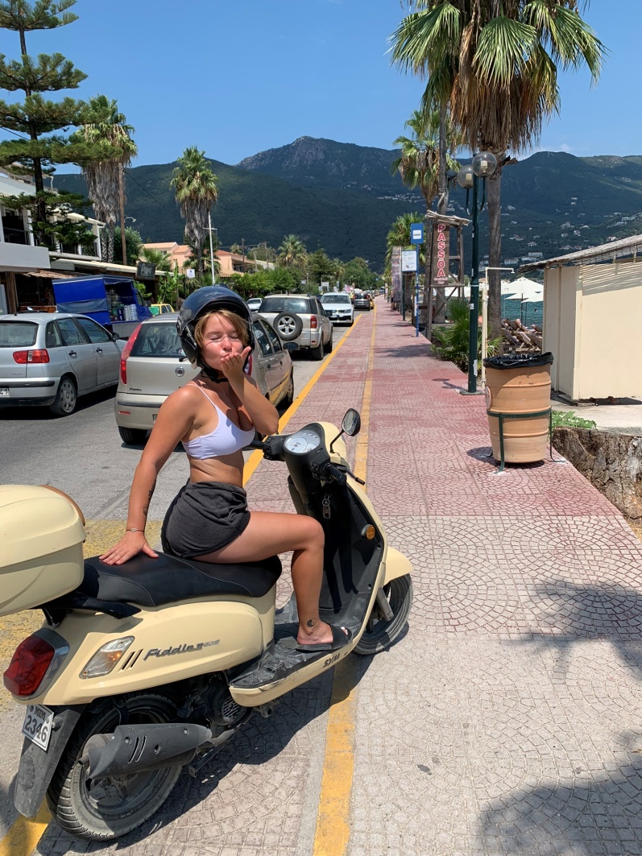
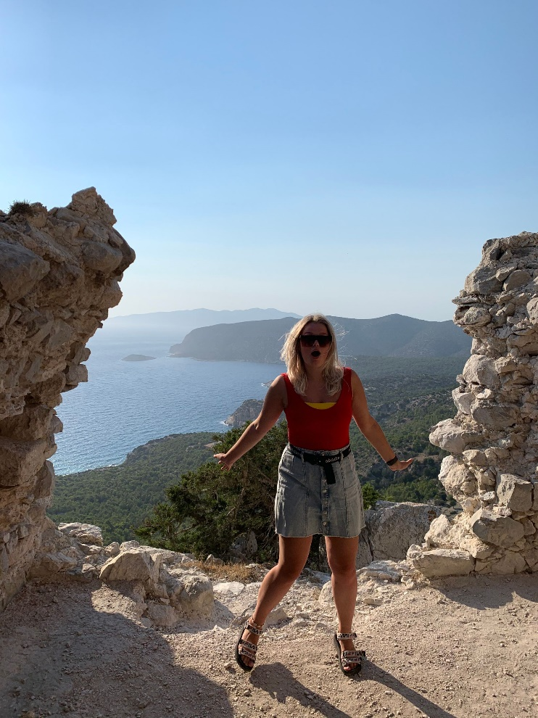
Gabriele, communication field student
“My internship in Corfu was definitely my most memorable experience and the biggest learning opportunity I had so far.I really recommend it as an experience not only to explore a different culture and its people, but also to explore and overcome your own limits and capabilities. It was a great opportunity for personal growth and enlightenment. I would do it again.”
Deimante ,creative industries student
“This summer I decided to try something new, so I applied for Erasmus+ traineeship in Greece. I had an opportunity to work in Rhodes, Amada Colossus Resort. I met so many kind-hearted people, everybody were trying to make sure that I’m happy and they made me feel safe. Also, this traineeship helped me to improve my English language skills, I had to leave my comfort zone behind and try a lot of new things that made me even more open-minded person.

Slide 18
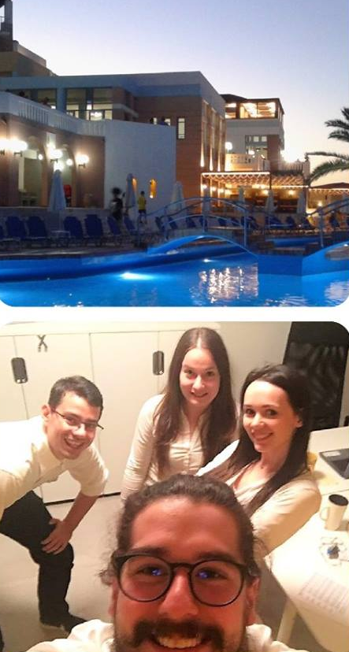
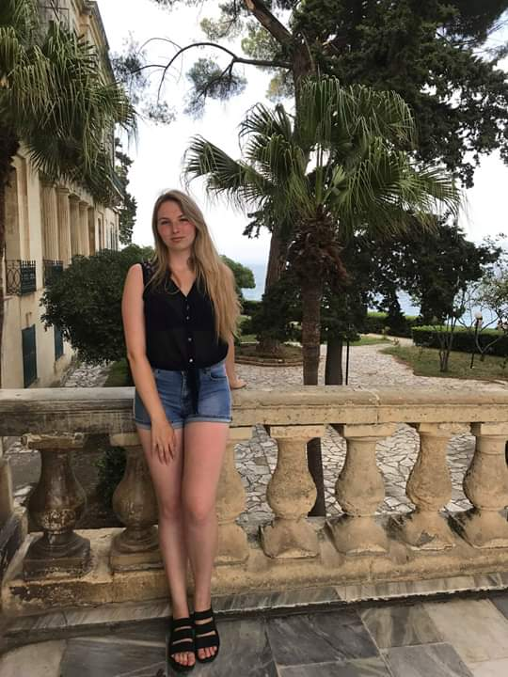
Marlena, Sylwia, Michal and Arnold, Warsaw, Poland – office trainees in Greece
“We were friends back to Poland and we never thought that we will have opportunity one day all together to make internship abroad. We are thankful to Amber Job for this amazing chance. We learned a lot about hotels business and we still having the best time here in GREECE. This country has perfect weather, beautiful nature and super friendly people ! ! !.”
Danguole, German language study program student. “Summer was amazing. This summer I made my practice in Eva Palace hotel, Corfu island, Greece. I can say it was great experience. Here I have learned to step out off my comfort zone and start conversations with new people without any fear. Definitely, I become more confident. Also during my practice I improved my German, English and Russian language skills. What I would like to emphasize is the friendships, that I made in Greece, they are priceless. I would recommend anyone to work in a foreign country, it will change your point of view in life.”

Slide 19
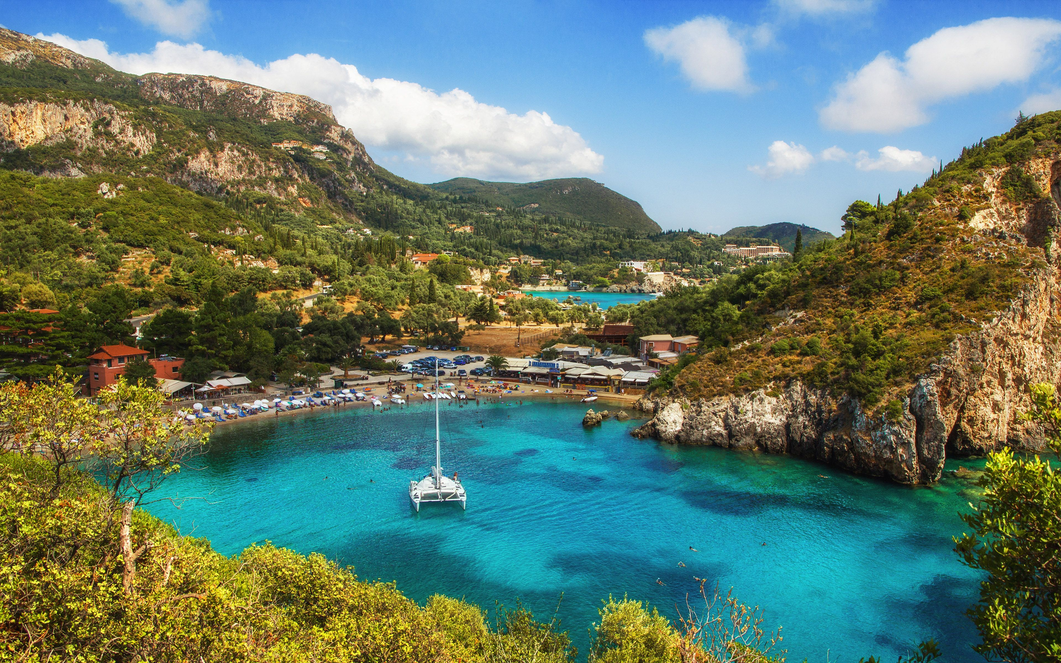
Life is an open book full of white pages.
You write the story as you go…

Slide 20






Do not wait apply now !
www.amberjob.eu
amberjobeu@gmail.com
+370 67603174
www.facebook.com/amberjob.eu

